Slide 1
NextHikes IT Solutions
Project-1
Bike Sharing Demand Analysis Project Using Excel

Slide 2
Agenda
Bike Sharing Demand Overview
Weekday vs Weekend Rental Analysis
Day-wise User Behaviour Analysis
Weather-wise Bike Rental Demand
Monthly Performance Comparison
Casual vs Registered User Comparison
Key Insights & Observations
Conclusion

Slide 3
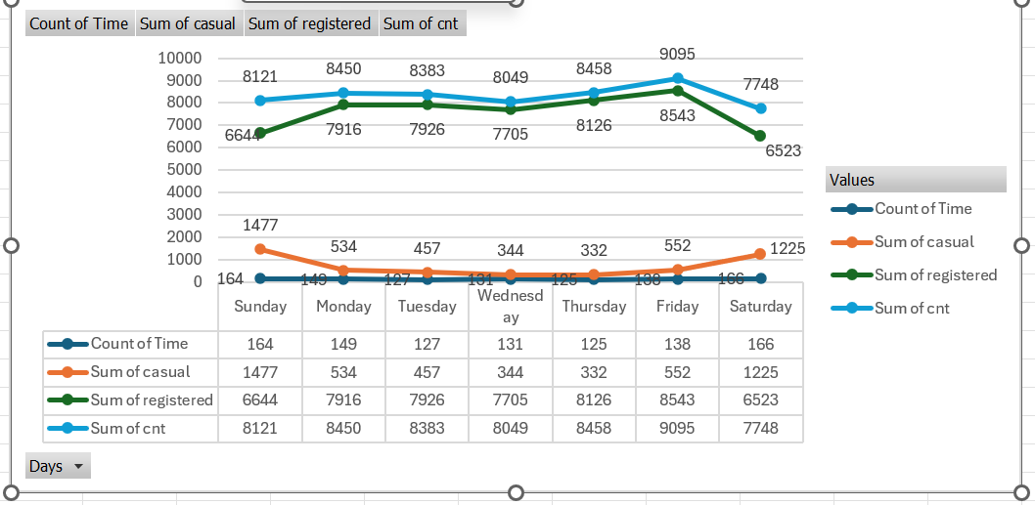

Slide 4
Bike Sharing Demand Overview
The bar chart clearly indicates that bike rentals are higher on weekends compared to weekdays.
During weekdays, bikes are rented less frequently than on weekends.
Casual bike rentals are significantly higher on weekends, while they are lower on weekdays.
The number of registered users is higher on Thursday and Friday compared to other days of the week.
The total number of bike rentals (cnt) also peaks on Thursday and Friday.

Slide 5
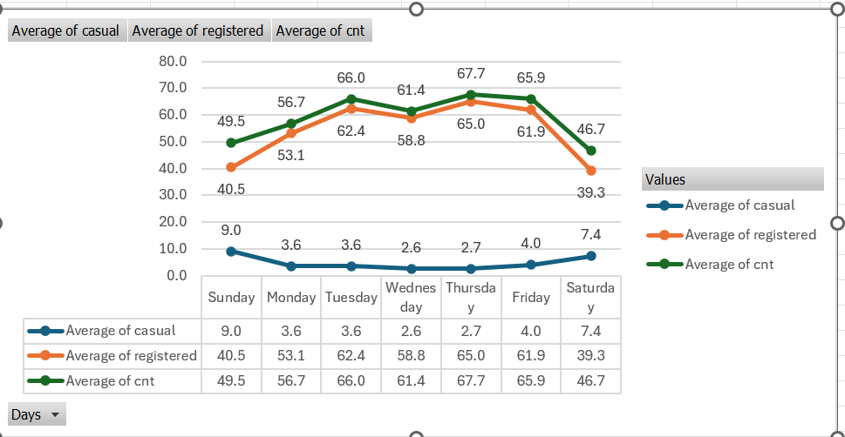

Slide 6
Weekday vs Weekend Rental Analysis
Weekday rentals are driven primarily by registered users, indicating regular commuting patterns.
Total bike demand is higher on weekdays, with peak usage observed on Thursday and Friday.
Weekend rentals show increased casual user participation, reflecting leisure and recreational travel.
Despite higher casual usage on weekends, overall rentals remain lower than peak weekdays due to reduced registered user activity

Slide 7
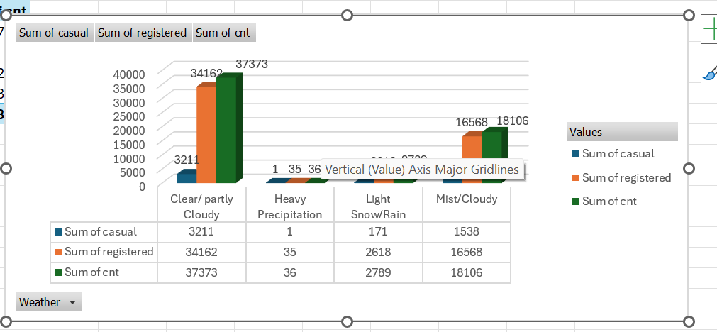

Slide 8
Weather-wise Bike Rental Demand
Clear and partly cloudy weather drives the highest bike rentals, showing strong user preference for favorable conditions.
Registered users contribute the majority of demand across all weather types, highlighting consistent usage patterns.
Rental demand declines significantly during rain and snow, indicating sensitivity to adverse weather conditions.
Heavy precipitation results in minimal bike usage, making weather forecasting critical for operational planning.

Slide 9
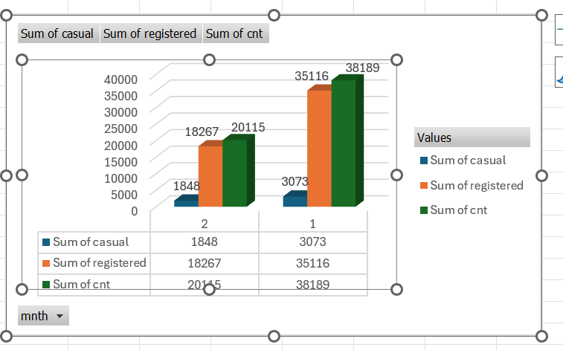

Slide 10
Monthly Performance Comparison
Registered users drive most of the total usage in both months.
Month 1 outperforms Month 2 across all metrics.
Casual user contribution is comparatively small but stable.
Total count closely follows the registered user trend.

Slide 12
Casual vs Registered User Comparison
Registered users dominate total bike usage throughout the week, indicating regular commuting behavior.
Midweek (Tuesday–Thursday) records the highest demand, with a clear peak on Thursday, driven mainly by
registered users.
Casual user activity increases on weekends, especially on Saturday and Sunday, reflecting leisure-oriented usage.
Registered user demand declines on weekends, resulting in lower overall rentals despite higher casual participation.

Slide 13
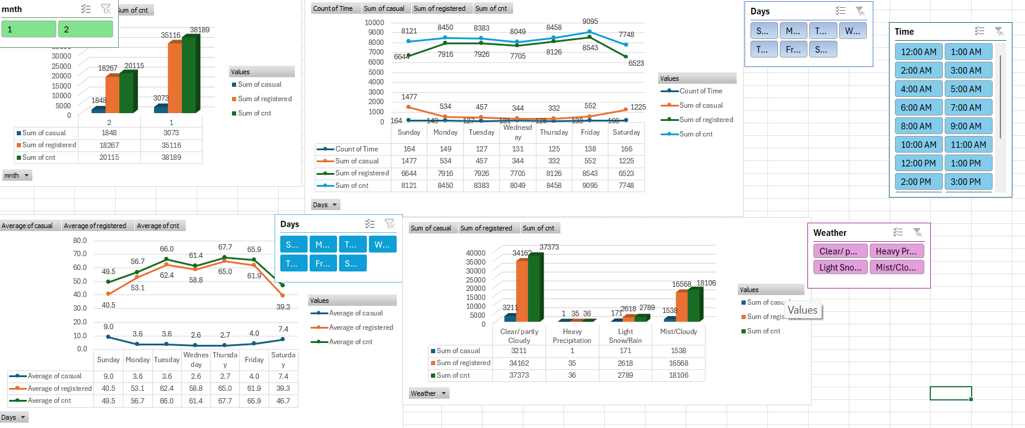

Slide 14
Key Insights & Observations
Registered users are the primary contributors to bike rentals, especially on weekdays, indicating strong commuting behavior.
Peak demand occurs on Thursday and Friday, suggesting higher mid-week mobility requirements.
Casual users show higher activity on weekends, reflecting leisure and recreational usage patterns.
Weather significantly influences demand—clear and partly cloudy conditions drive maximum usage, while rain and snow sharply reduce rentals.

Slide 15
Conclusion
Registered users dominate bike rentals, with peak demand on Thursday and Friday, showing strong weekday commuting patterns.
Casual users are more active on weekends, indicating leisure-based usage, while overall demand drops on Sundays.
Weather significantly impacts demand—clear conditions drive maximum usage, while rain and heavy precipitation sharply reduce rentals.

Slide 16
  Thank You

